Slide 1

Find All My Friends Crossing Platform Borders
Projektvorstellung
Eingebettete Betriebssysteme
8. Feburar 2012

Slide 2

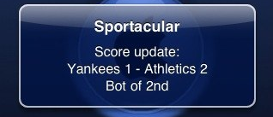
Push Notifications
iOS
Application-Limitations:
application not active every time
no background threads
no running at standby
Local Notification
time event
Remote Notification
remote

